Slide 1
Appendix E
Embedded Systems

Slide 2
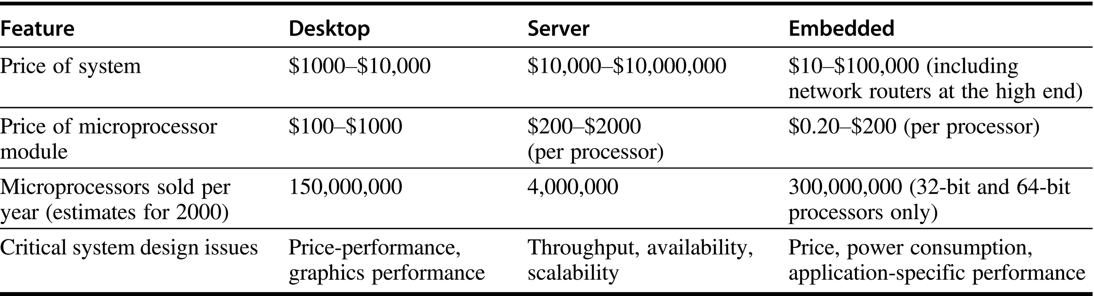
Figure E.1 A summary of the three computing classes and their system characteristics. Note the wide range in system price for servers and embedded systems. For servers, this range arises from the need for very large-scale multiprocessor systems for high-end transaction processing and Web server applications. For embedded systems, one significant high-end application is a network router, which could include multiple processors as well as lots of memory and other electronics. The total number of embedded processors sold in 2000 is estimated to exceed 1 billion, if you include 8-bit and 16-bit microprocessors. In fact, the largest-selling microprocessor of all time is an 8-bit microcontroller sold by Intel! It is difficult to separate the low end of the server market from the desktop market, since low-end servers—especially those costing less than $5000—are essentially no different from desktop PCs. Hence, up to a few million of the PC units may be effectively servers.

Slide 3
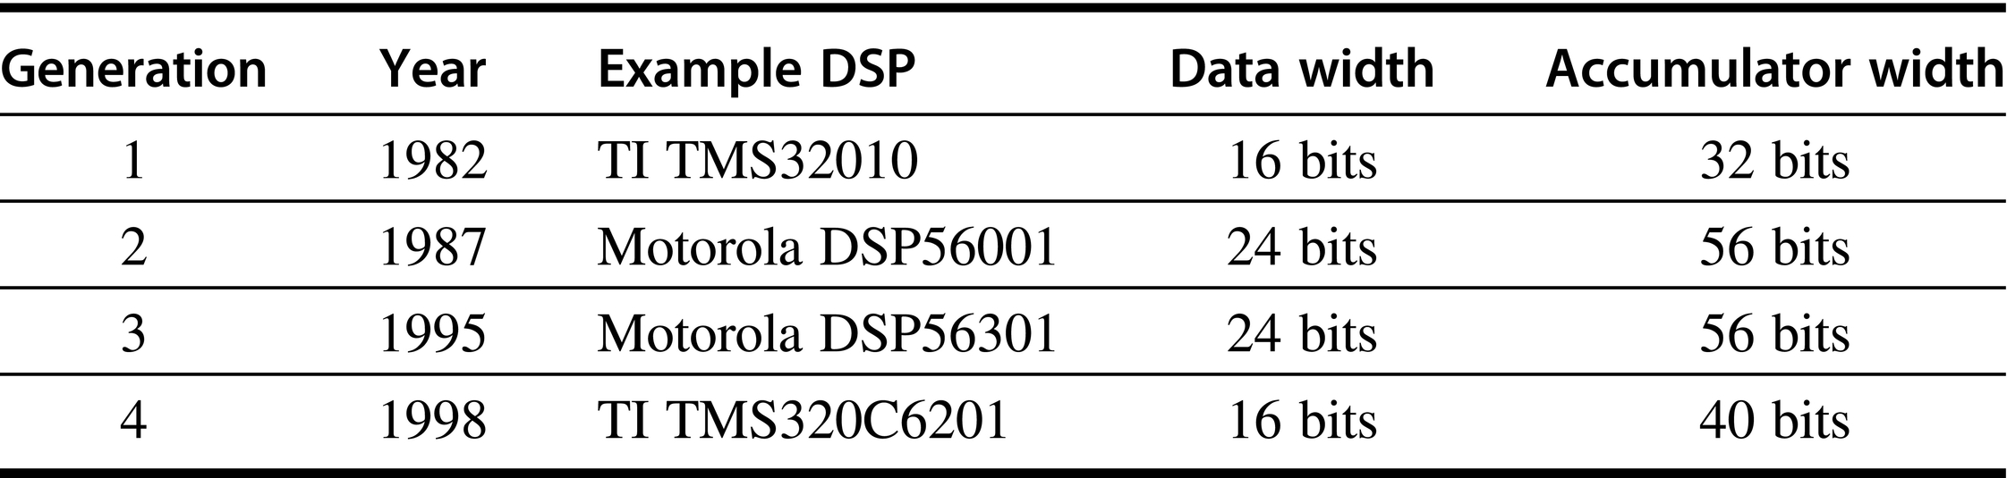
Figure E.2 Four generations of DSPs, their data width, and the width of the registers that reduces round-off error.

Slide 4
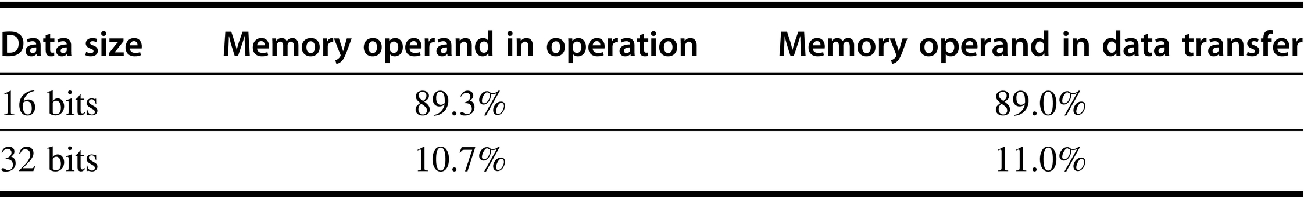
Figure E.3 Size of data operands for the TMS320C55 DSP. About 90% of operands are 16 bits. This DSP has two 40-bit accumulators. There are no floating-point operations, as is typical of many DSPs, so these data are all fixed-point integers.

Slide 5
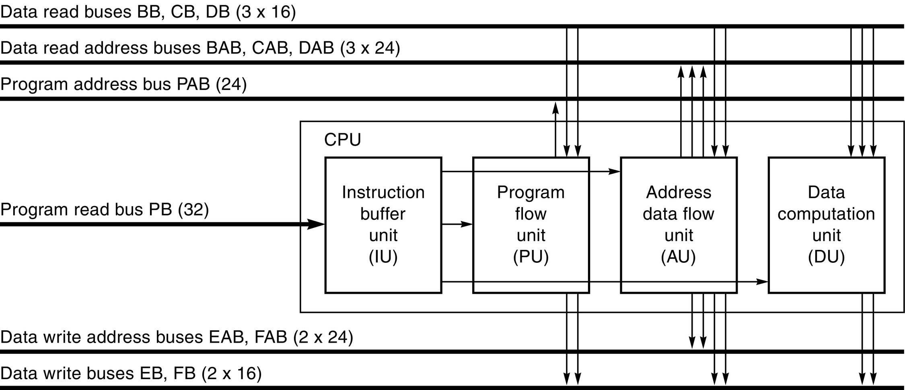
Figure E.4 Architecture of the TMS320C55 DSP. The C55 is a seven-stage pipelined processor with some unique instruction execution facilities. (Courtesy Texas Instruments.)

Slide 6
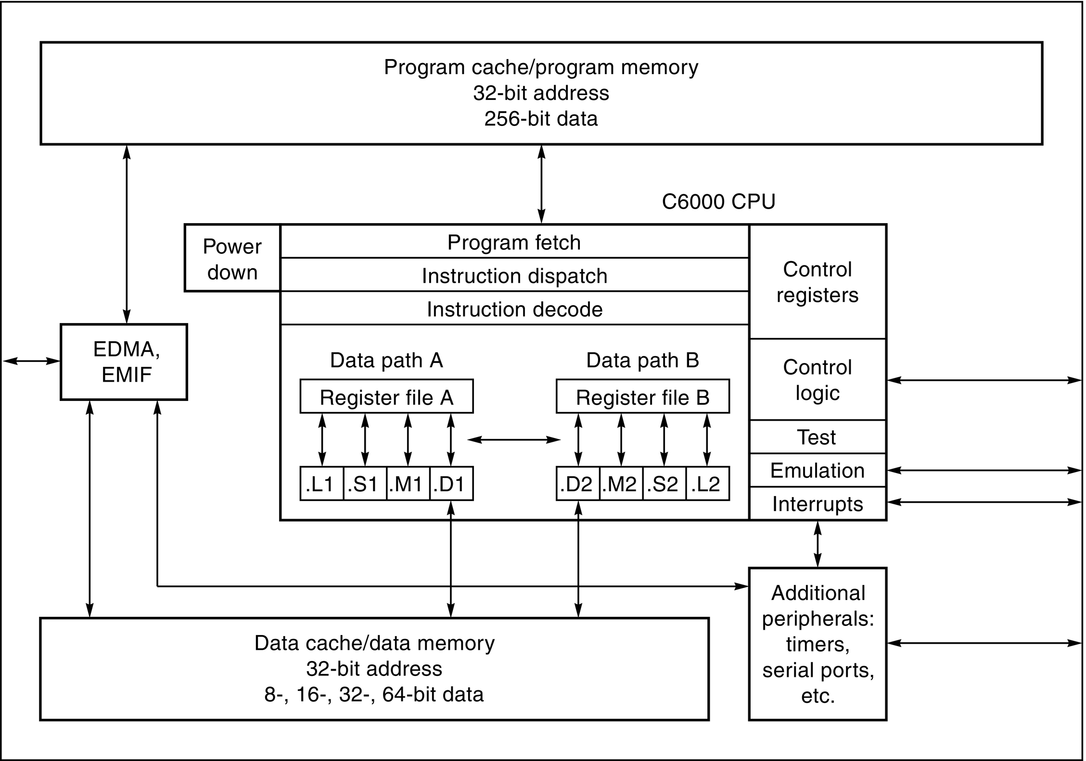
Figure E.5 Architecture of the TMS320C64x family of DSPs. The C6x is an eight-issue traditional VLIW processor. (Courtesy Texas Instruments.)

Slide 7
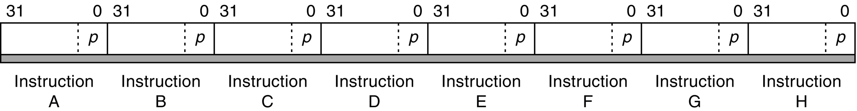
Figure E.6 Instruction packet of the TMS320C6x family of DSPs. The p bits determine whether an instruction begins a new VLIW word or not. If the p bit of instruction i is 1, then instruction i + 1 is to be executed in parallel with (in the same cycle as) instruction i. If the p bit of instruction i is 0, then instruction i + 1 is executed in the cycle after instruction i. (Courtesy Texas Instruments.)

Slide 8
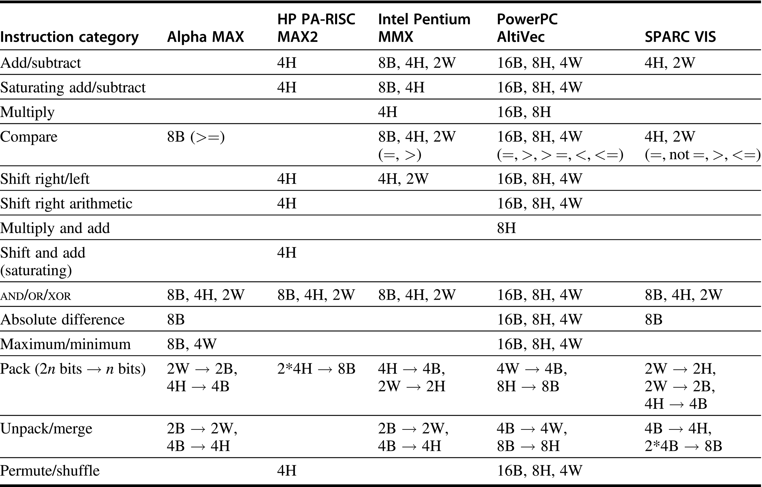
Figure E.7 Summary of multimedia support for desktop processors. Note the diversity of support, with little in common across the five architectures. All are fixed-width operations, performing multiple narrow operations on either a 64-bit or 128-bit ALU. B stands for byte (8 bits), H for half word (16 bits), and W for word (32 bits). Thus, 8B means an operation on 8 bytes in a single instruction. Note that AltiVec assumes a 128-bit ALU, and the rest assume 64 bits. Pack and unpack use the notation 2*2W to mean 2 operands each with 2 words. This table is a simplification of the full multimedia architectures, leaving out many details. For example, HP MAX2 includes an instruction to calculate averages, and SPARC VIS includes instructions to set registers to constants. Also, this table does not include the memory alignment operation of AltiVec, MAX, and VIS.

Slide 9
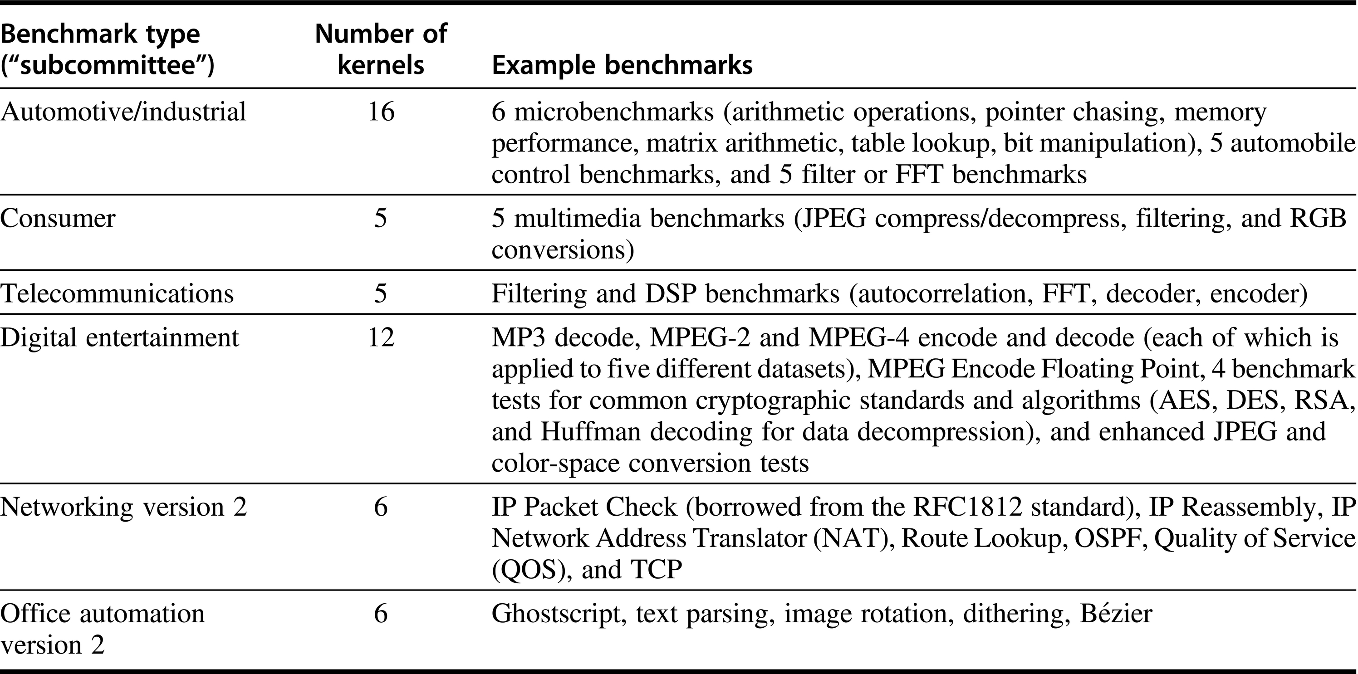
Figure E.8 The EEMBC benchmark suite, consisting of 50 kernels in six different classes. See www.eembc.org for more information on the benchmarks and for scores.

Slide 10
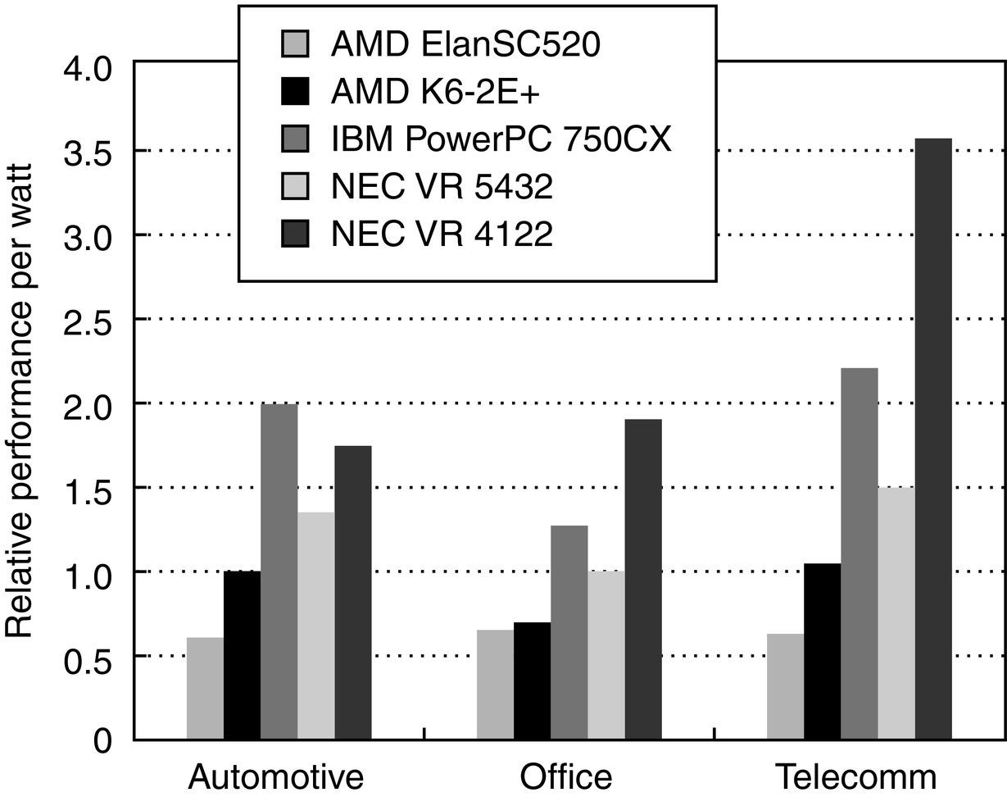
Figure E.9 Relative performance per watt for the five embedded processors. The power is measured as typical operating power for the processor and does not include any interface chips.

Slide 11
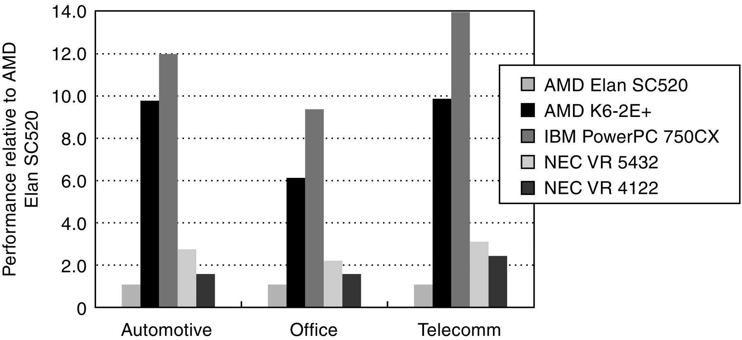
Figure E.10 Raw performance for the five embedded processors. The performance is presented as relative to the performance of the AMD ElanSC520.

Slide 12
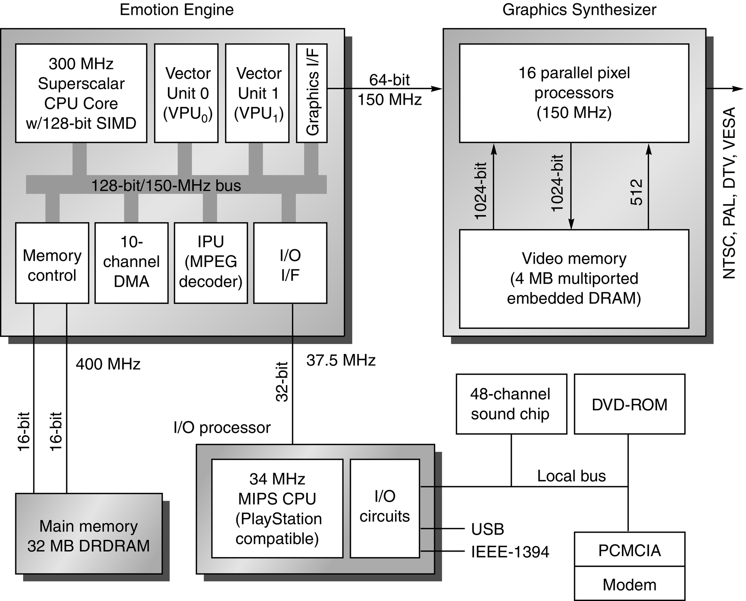
Figure E.11 Block diagram of the Sony PlayStation 2. The 10 DMA channels orchestrate the transfers between all the small memories on the chip, which when completed all head toward the Graphics Interface so as to be rendered by the Graphics Synthesizer. The Graphics Synthesizer uses DRAM on chip to provide an entire frame buffer plus graphics processors to perform the rendering desired based on the display commands given from the Emotion Engine. The embedded DRAM allows 1024-bit transfers between the pixel processors and the display buffer. The Superscalar CPU is a 64-bit MIPS III with two-instruction issue, and comes with a two-way, set associative, 16 KB instruction cache; a two-way, set associative, 8 KB data cache; and 16 KB of scratchpad memory. It has been extended with 128-bit SIMD instructions for multimedia applications (see Section E.2). Vector Unit 0 is primarily a DSP-like coprocessor for the CPU (see Section E.2), which can operate on 128-bit registers in SIMD manner between 8 bits and 32 bits per word. It has 4 KB of instruction memory and 4 KB of data memory. Vector Unit 1 has similar functions to VPU0, but it normally operates independently of the CPU and contains 16 KB of instruction memory and 16 KB of data memory. All three units can communicate over the 128-bit system bus, but there is also a 128-bit dedicated path between the CPU and VPU0 and a 128-bit dedicated path between VPU1 and the Graphics Interface. Although VPU0 and VPU1 have identical microarchitectures, the differences in memory size and units to which they have direct connections affect the roles that they take in a game. At 0.25-micron line widths, the Emotion Engine chip uses 13.5M transistors and is 225 mm², and the Graphics Synthesizer is 279 mm². To put this in perspective, the Alpha 21264 microprocessor in 0.25-micron technology is about 160 mm² and uses 15M transistors. (This figure is based on Figure 1 in “Sony’s Emotionally Charged Chip,” Microprocessor Report 13:5.)

Slide 13
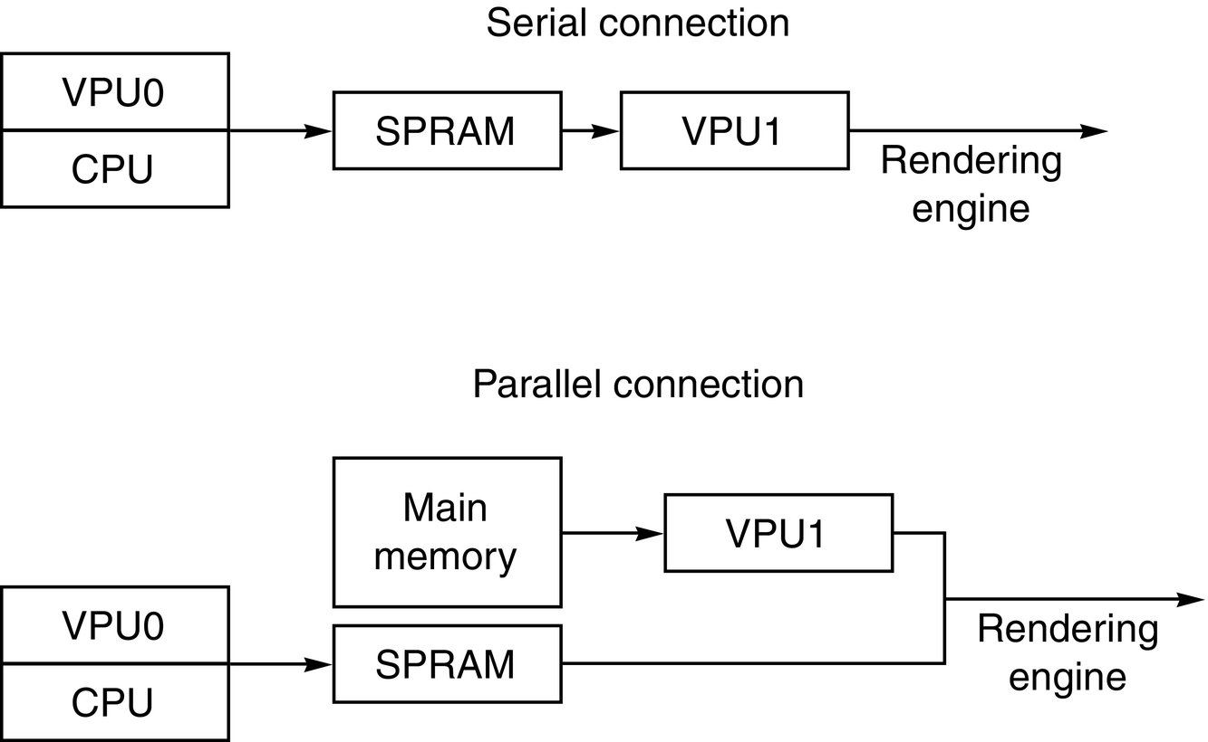
Figure E.12 Two modes of using Emotion Engine organization. The first mode divides the work between the two units and then allows the Graphics Interface to properly merge the display lists. The second mode uses CPU/VPU0 as a filter of what to send to VPU1, which then does all the display lists. It is up to the programmer to choose between serial and parallel data flow. SPRAM is the scratchpad memory.

Slide 14
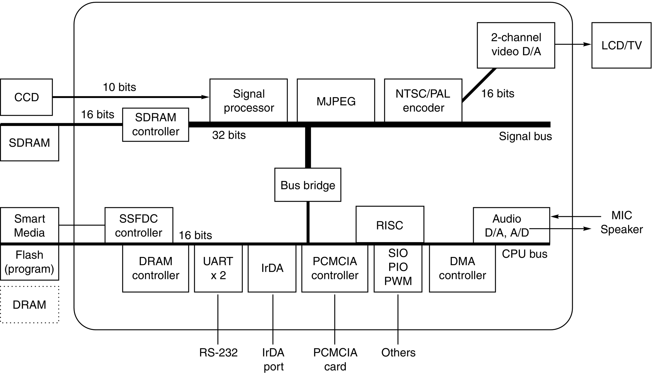
Figure E.13 The system on a chip (SOC) found in Sanyo digital cameras. This block diagram, found in Okada et al. [1999], is for the predecessor of the SOC in the camera described in the text. The successor SOC, called Super Advanced IC, uses three buses instead of two, operates at 60 MHz, consumes 800 mW, and fits 3.1M transistors in a 10.2 × 10.2 mm die using a 0.35-micron process. Note that this embedded system has twice as many transistors as the state-of-the-art, high-performance microprocessor in 1990! The SOC in the figure is limited to processing 1024 × 768 pixels, but its successor supports 1360 × 1024 pixels.

Slide 15
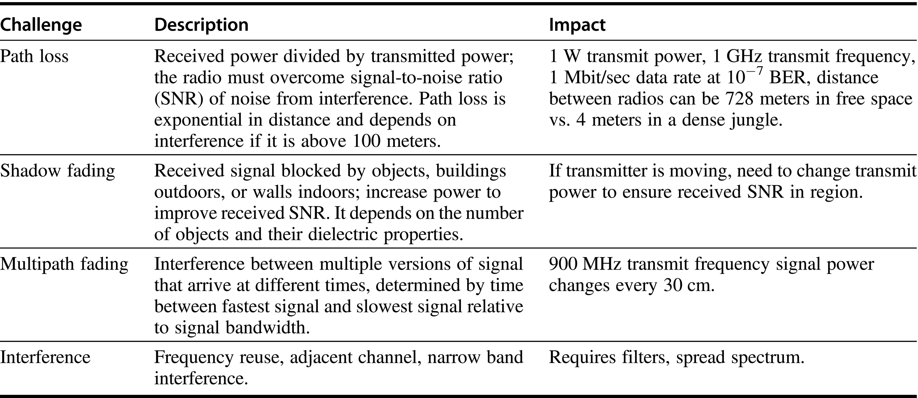
Figure E.14 Challenges for wireless communication.

Slide 16
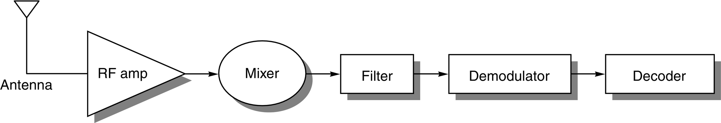
Figure E.15 A radio receiver consists of an antenna, radio frequency amplifier, mixer, filters, demodulator, and decoder. A mixer accepts two signal inputs and forms an output signal at the sum and difference frequencies. Filters select a narrower band of frequencies to pass on to the next stage. Modulation encodes information to make it more robust. Decoding turns signals into information. Depending on the application, all electrical components can be either analog or digital. For example, a car radio is all analog components, but a PC modem is all digital except for the amplifier. Today analog silicon chips are used for the RF amplifier and first mixer in cellular phones.

Slide 17
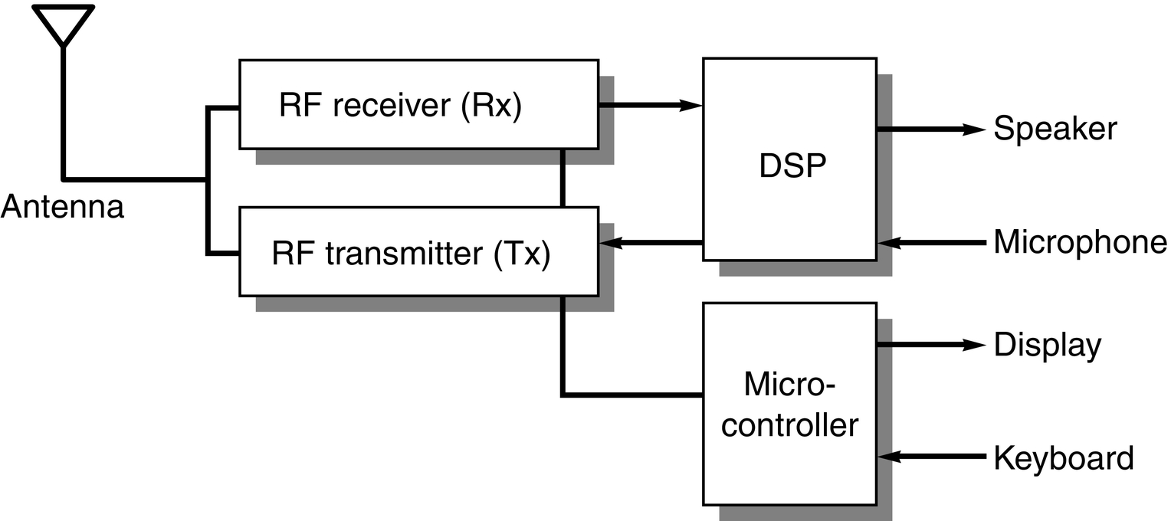
Figure E.16 Block diagram of a cell phone. The DSP performs the signal processing steps of Figure E.15, and the microcontroller controls the user interface, battery management, and call setup. (Based on Figure 1.3 of Groe and Larson [2000].)

Slide 18
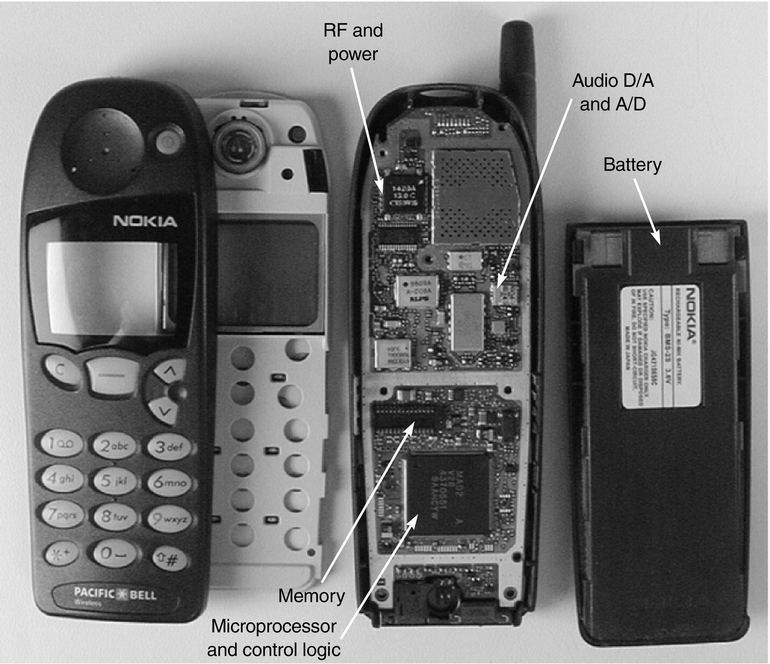
Figure E.17 Circuit board from a Nokia cell phone. (Courtesy HowStuffWorks, Inc.)

